Slide 1
Chapter 12
XML: Extensible Markup Language

Slide 2
Chapter 12 Outline
Structured, Semistructured,
and Unstructured Data
XML Hierarchical (Tree) Data Model
XML Documents, DTD, and XML Schema
Storing and Extracting XML Documents from Databases
XML Languages
Extracting XML Documents from Relational Databases

Slide 3
XML: Extensible
Markup Language
Data sources
  Database storing data for Internet applications
Hypertext documents
  Common method of specifying contents and formatting of Web pages
XML data model

Slide 4
Structured, Semistructured, and Unstructured Data
Structured data
  Represented in a strict format
  Example: information stored in databases
Semistructured data
  Has a certain structure
  Not all information collected will have identical structure

Slide 5
Structured, Semistructured, and Unstructured Data (cont’d.)
  Schema information mixed in with data values
  Self-describing data
  May be displayed as a directed graph
    Labels or tags on directed edges represent:
      Schema names
      Names of attributes
      Object types (or entity types or classes)
      Relationships

Slide 6
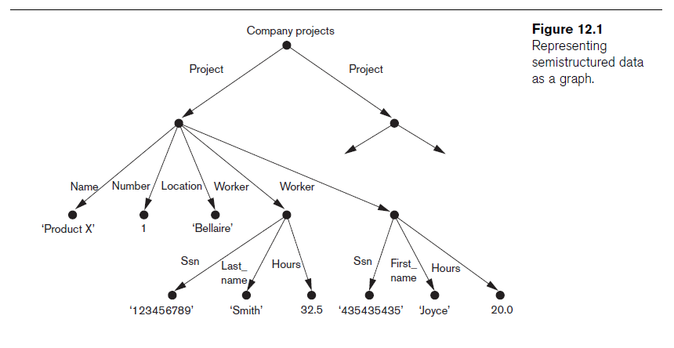
Structured, Semistructured, and Unstructured Data (cont’d.)

Slide 7
Structured, Semistructured, and Unstructured Data (cont’d.)
Unstructured data
  Limited indication of the of data document that contains information embedded within it
HTML tag
  Text that appears between angled brackets: <...>
End tag
  Tag with a slash: </...>

Slide 8
Structured, Semistructured, and Unstructured Data (cont’d.)
HTML uses a large number of predefined tags
HTML documents
  Do not include schema information about type of data
Static HTML page
  All information to be displayed explicitly spelled out as fixed text in HTML file

Slide 9
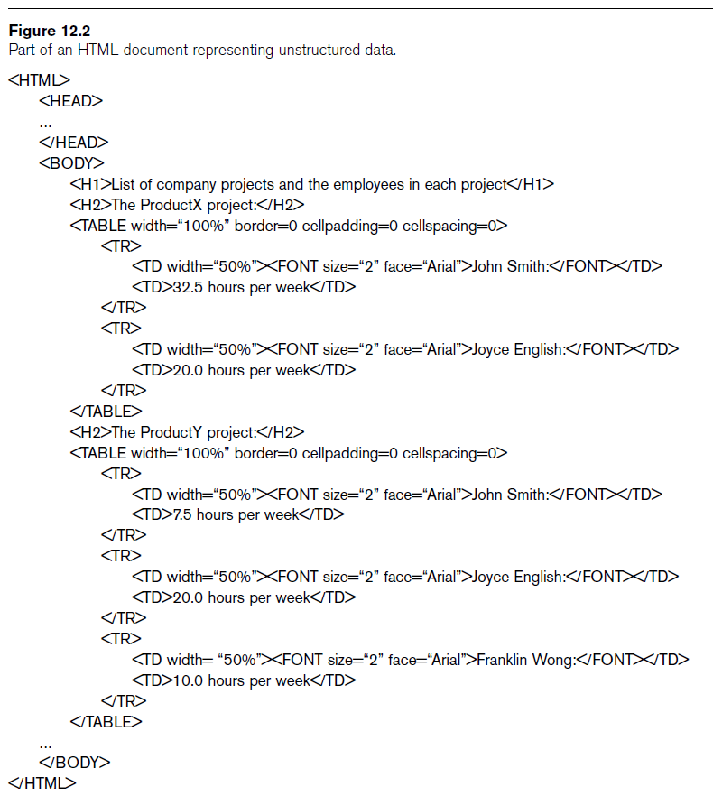

Slide 10
XML Hierarchical (Tree) Data Model
Elements and attributes
  Main structuring concepts used to construct an XML document
Complex elements
  Constructed from other elements hierarchically
Simple elements
  Contain data values
XML tag names
  Describe the meaning of the data elements in the document

Slide 11
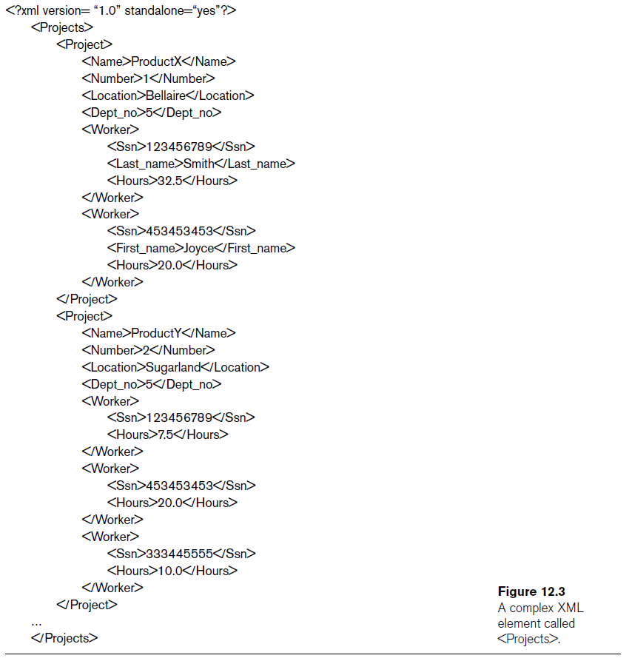

Slide 12
XML Hierarchical (Tree) Data Model (cont’d.)
Tree model or hierarchical model
Main types of XML documents
  Data-centric XML documents
  Document-centric XML documents
  Hybrid XML documents
Schemaless XML documents
  Do not follow a predefined schema of element names and corresponding tree structure

Slide 13
XML Hierarchical (Tree) Data Model (cont’d.)
XML attributes
  Describe properties and characteristics of the elements (tags) within which they appear
May reference another element in another part of the XML document
  Common to use attribute values in one element as the references

Slide 14
XML Documents, DTD, and XML Schema
Well formed
  Has XML declaration
    Indicates version of XML being used as well as any other relevant attributes
  Every element must matching pair of start and end tags
    Within start and end tags of parent element
DOM (Document Object Model)
  Manipulate resulting tree representation corresponding to a well-formed XML document

Slide 15
XML Documents, DTD, and XML Schema (cont’d.)
SAX (Simple API for XML)
  Processing of XML documents on the fly
    Notifies processing program through callbacks whenever a start or end tag is encountered
  Makes it easier to process large documents
  Allows for streaming

Slide 16
XML Documents, DTD, and XML Schema (cont’d.)
Valid
  Document must be well formed
  Document must follow a particular schema
  Start and end tag pairs must follow structure specified in separate XML DTD (Document Type Definition) file or XML schema file

Slide 17
XML Documents, DTD, and XML Schema (cont’d.)
Notation for specifying elements
XML DTD
  Data types in DTD are not very general
  Special syntax
    Requires specialized processors
  All DTD elements always forced to follow the specified ordering of the document
    Unordered elements not permitted

Slide 18
XML Schema
XML schema language
  Standard for specifying the structure of XML documents
  Uses same syntax rules as regular XML documents
    Same processors can be used on both

Slide 19
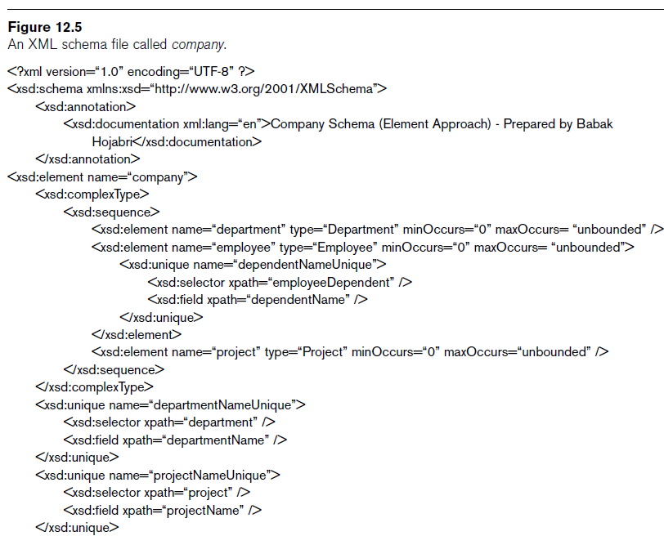

Slide 20
XML Schema (cont’d.)
Identify specific set of XML schema language elements (tags) being used
  Specify a file stored at a Web site location
XML namespace
  Defines the set of commands (names) that can be used

Slide 21
XML Schema (cont’d.)
XML schema concepts:
  Description and XML namespace
  Annotations, documentation, language
  Elements and types
  First level element
  Element types, minOccurs, and maxOccurs
  Keys
  Structures of complex elements
  Composite attributes

Slide 22
Storing and Extracting XML Documents from Databases
Most common approaches
  Using a DBMS to store the documents as text
    Can be used if DBMS has a special module for document processing
  Using a DBMS to store document contents as data elements
    Require mapping algorithms to design a database schema that is compatible with XML document structure

Slide 23
Storing and Extracting XML Documents from Databases (cont’d.)
  Designing a specialized system for storing native XML data
    Called Native XML DBMSs
  Creating or publishing customized XML documents from preexisting relational databases
    Use a separate middleware software layer to handle conversions

Slide 24
XML Languages
Two query language standards
  XPath
    Specify path expressions to identify certain nodes (elements) or attributes within an XML document that match specific patterns
  XQuery
    Uses XPath expressions but has additional constructs

Slide 25
XPath: Specifying Path Expressions in XML
XPath expression
  Returns a sequence of items that satisfy a certain pattern as specified by the expression
  Either values (from leaf nodes) or elements or attributes
  Qualifier conditions
    Further restrict nodes that satisfy pattern
Separators used when specifying a path:
  Single slash (/) and double slash (//)

Slide 26
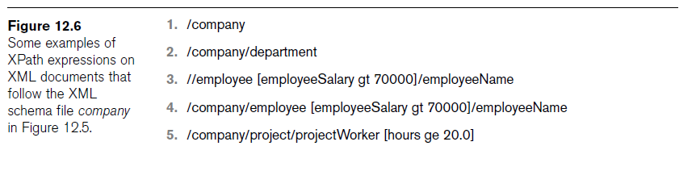
XPath: Specifying Path Expressions in XML (cont’d.)

Slide 27
XPath: Specifying Path Expressions in XML (cont’d.)
Attribute name prefixed by the @ symbol
Wildcard symbol *
  Stands for any element
  Example: /company/*

Slide 28
XPath: Specifying Path Expressions in XML (cont’d.)
Axes
  Move in multiple directions from current node in path expression
  Include self, child, descendent, attribute, parent, ancestor, previous sibling, and next sibling

Slide 29
XPath: Specifying Path Expressions in XML (cont’d.)
Main restriction of XPath path expressions
  Path that specifies the pattern also specifies the items to be retrieved
  Difficult to specify certain conditions on the pattern while separately specifying which result items should be retrieved

Slide 30
XQuery: Specifying Queries in XML
XQuery FLWR expression
  Four main clauses of XQuery
  Form:
    FOR <variable bindings to individual nodes (elements)>
    LET <variable bindings to collections of nodes (elements)>
    WHERE <qualifier conditions>
    RETURN <query result specification>
  Zero or more instances of FOR and LET clauses

Slide 31
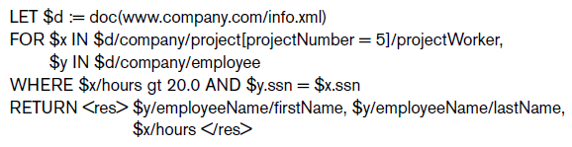
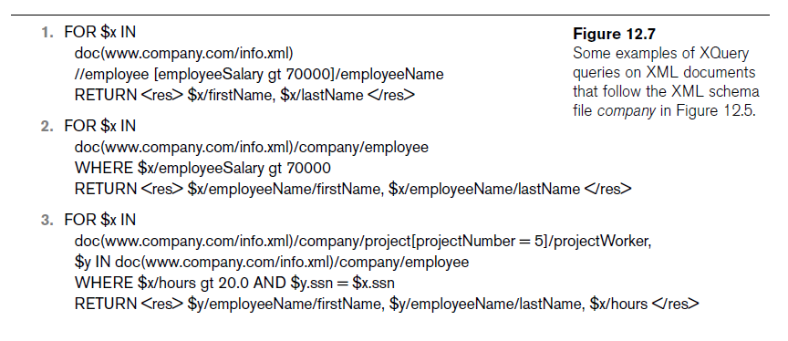

Slide 32
XQuery: Specifying Queries in XML (cont’d.)
XQuery contains powerful constructs to specify complex queries
www.w3.org
  Contains documents describing the latest standards related to XML and XQuery

Slide 33
Other Languages and Protocols Related to XML
Extensible Stylesheet Language (XSL)
  Define how a document should be rendered for display by a Web browser
Extensible Stylesheet Language for Transformations (XSLT)
  Transform one structure into different structure
Web Services Description Language (WSDL)
  Description of Web Services in XML

Slide 34
Other Languages and Protocols Related to XML (cont’d.)
Simple Object Access Protocol (SOAP)
  Platform-independent and programming language-independent protocol for messaging and remote procedure calls
Resource Description Framework (RDF)
  Languages and tools for exchanging and processing of meta-data (schema) descriptions and specifications over the Web

Slide 35
Extracting XML Documents from Relational Databases
Creating hierarchical XML views over flat or graph-based data
  Representational issues arise when converting data from a database system into XML documents
UNIVERSITY database example

Slide 36
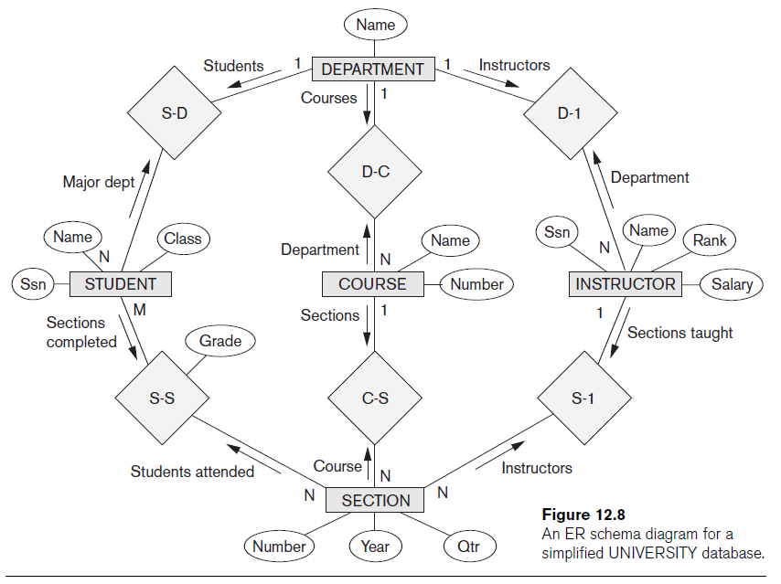

Slide 37
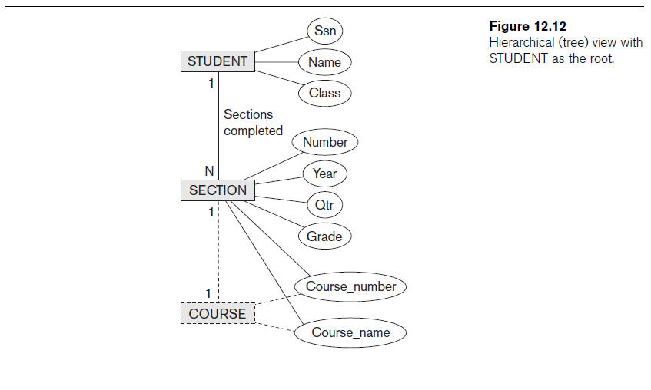

Slide 38
Breaking Cycles to Convert Graphs into Trees
Complex subset with one or more cycles
  Indicate multiple relationships among the entities
  Difficult to decide how to create the document hierarchies
Can replicate the entity types involved to break the cycles

Slide 39
Other Steps for Extracting XML Documents from Databases
Create correct query in SQL to extract desired information for XML document
Restructure query result from flat relational form to XML tree structure
Customize query to select either a single object or multiple objects into document

Slide 40
Summary
Three main types of data: structured, semi-structured, and unstructured
XML standard
  Tree-structured (hierarchical) data model
  XML documents and the languages for specifying the structure of these documents
XPath and XQuery languages
  Query XML data

